Slide 1


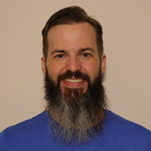
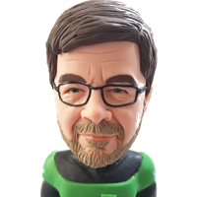


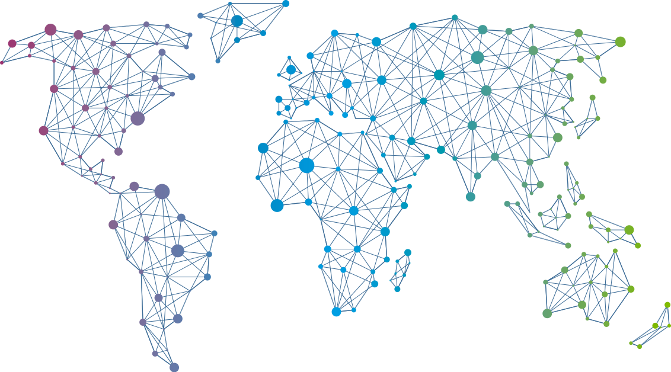

Speaker
Kyle Ruddy & Luc Dekens
Automation Showdown: Imperative vs Declarative
Kyle Ruddy
Luc Dekens
kmruddy
LucD22
September 16th & 17th
^{Online Event}
Powered By
International Conference

